Slide 1
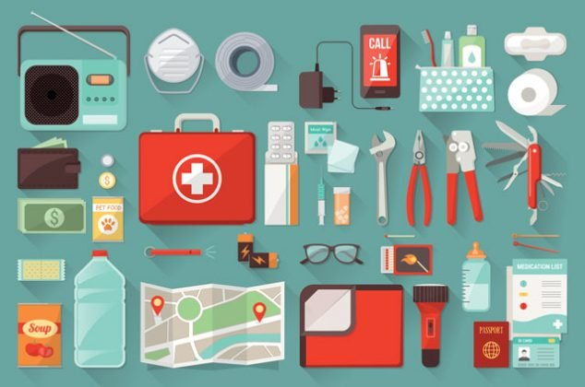
I’m Ready for an Emergency!

Slide 2
I live in a house with my family.

Slide 3
My house has all the things I need to be healthy and safe.

Slide 4
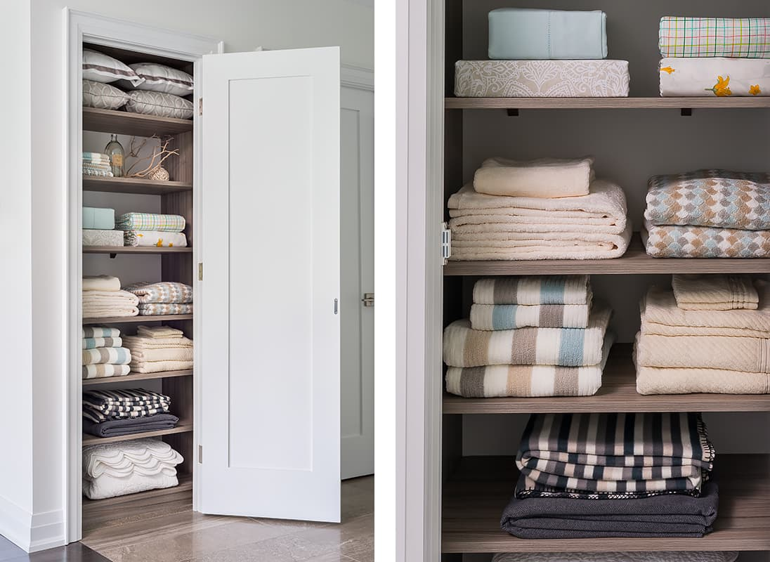
My house has food and water. My house has warm blankets.

Slide 5
In an emergency, I might need to leave my house.

Slide 6
An emergency is a dangerous event that happens very fast.

Slide 7
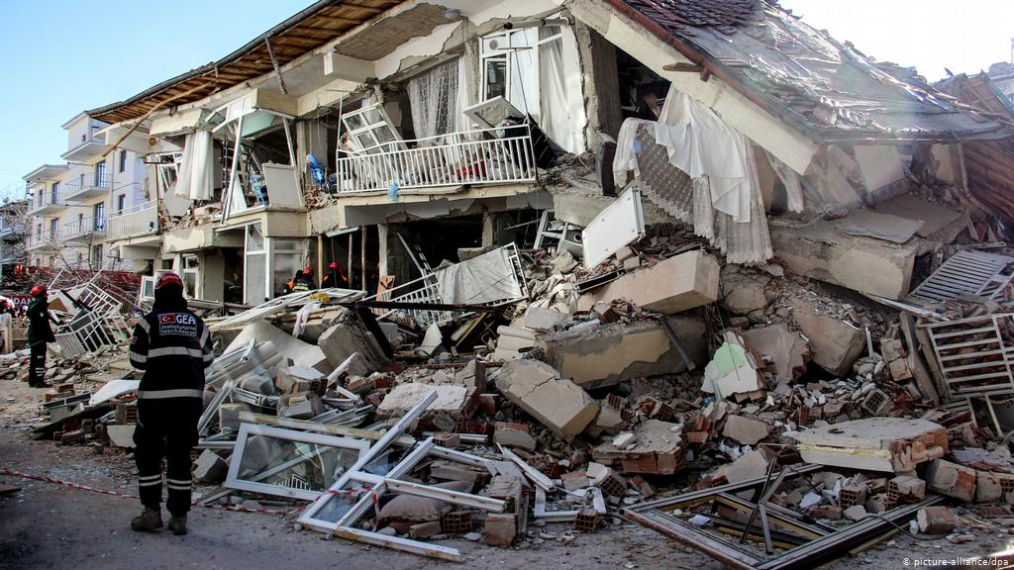
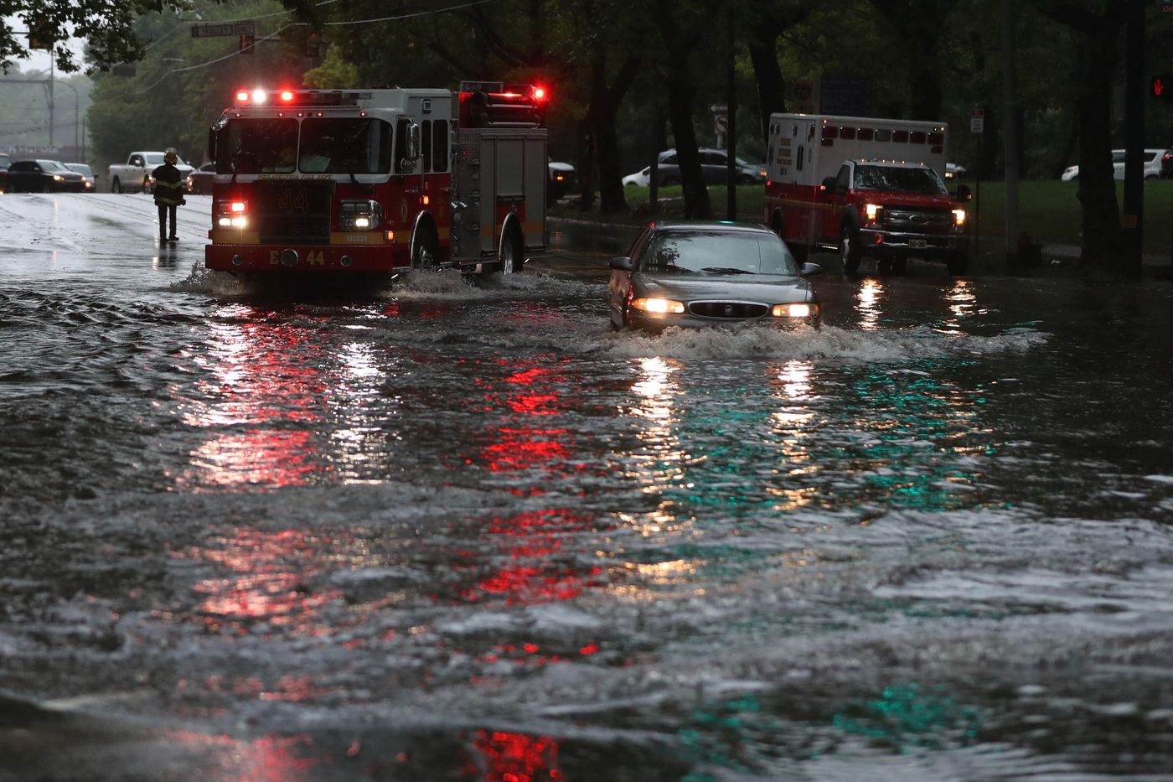
An emergency could be a fire, flood, or earthquake.

Slide 8
In an emergency, we might need to leave very quickly!

Slide 9
It is important to have things ready to go for an emergency.

Slide 10
My family should have an emergency bag packed.

Slide 11
My family should have a plan about what to do in an emergency.

Slide 12
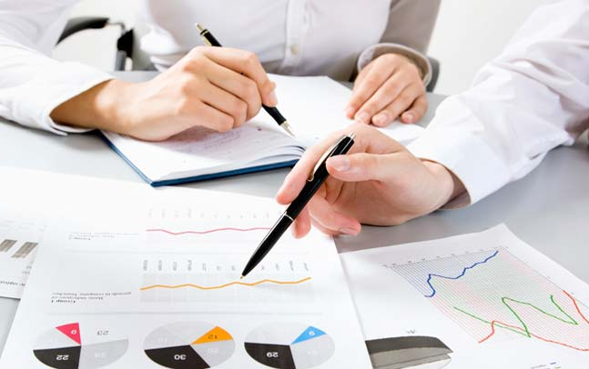
I am a part of this plan!

Slide 13
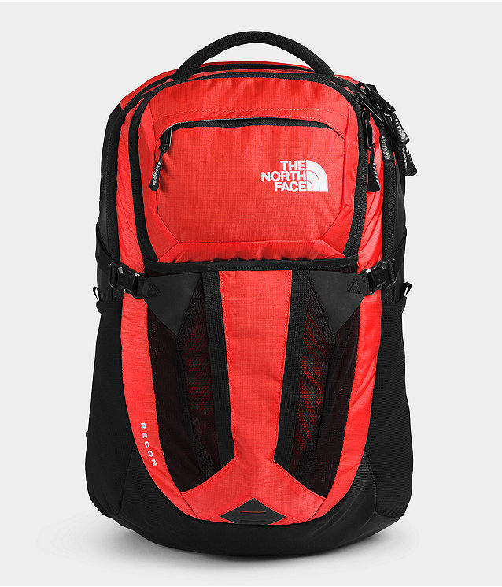
First, let’s pack an emergency bag. What do we need?

Slide 14
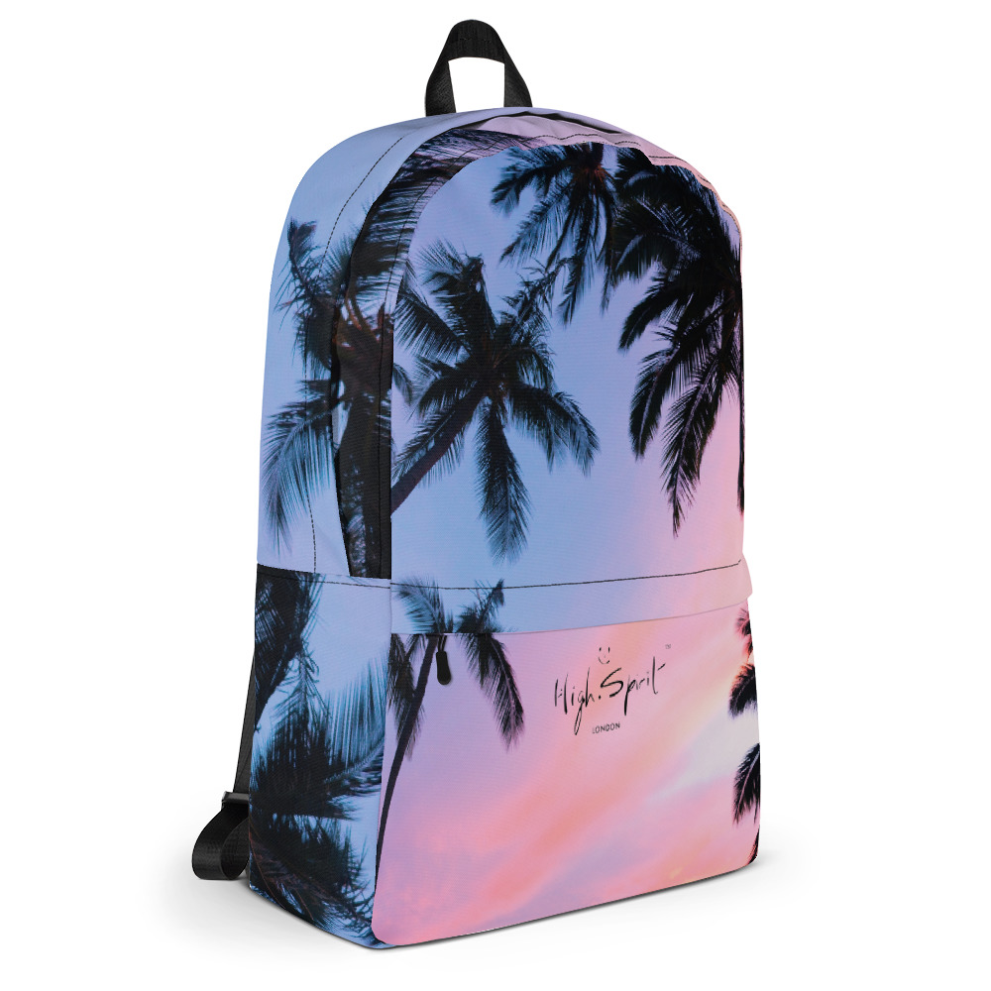
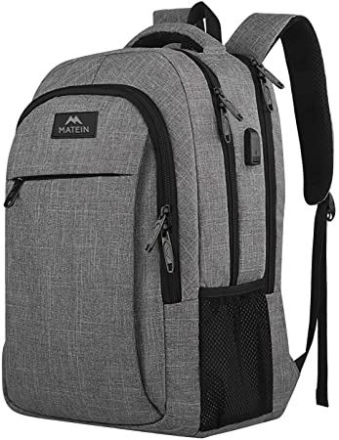
We need a bag to pack all of our things in. Any backpack will work great!

Slide 15
We need food and water. Food and water help our bodies be strong.

Slide 16
We should pack food that lasts a long time. Canned food is a great choice!

Slide 17
We need lots of water, too. We should have enough for every person in our family.

Slide 18
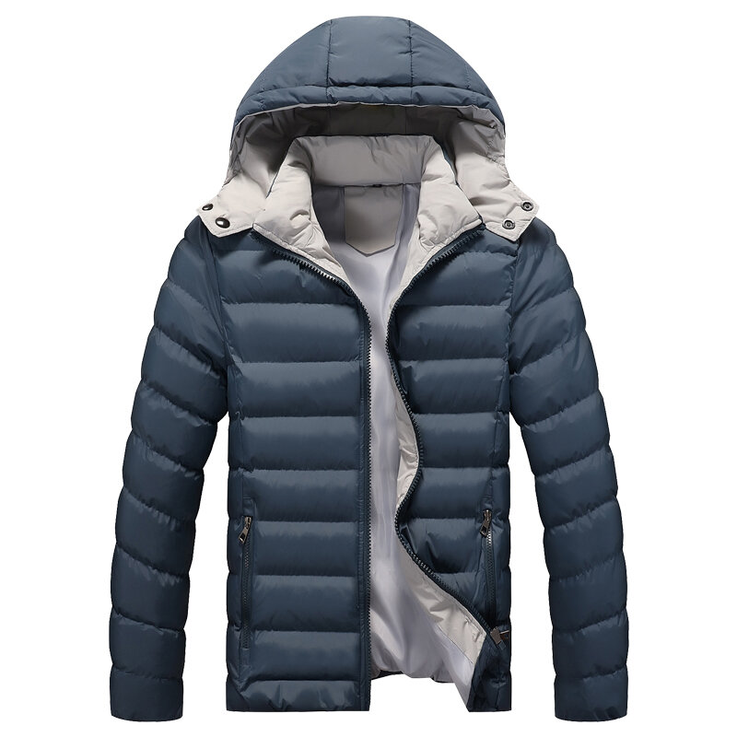
We also need to be warm outside. Jackets, sweaters, and blankets are important to have.

Slide 19
In an emergency, the power might go out. We need a way to light the area around us.

Slide 20
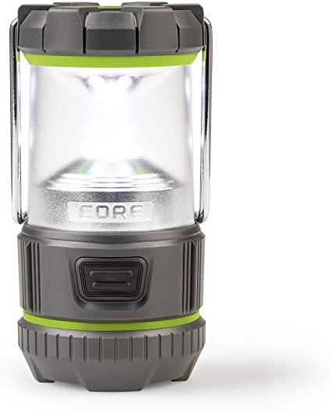
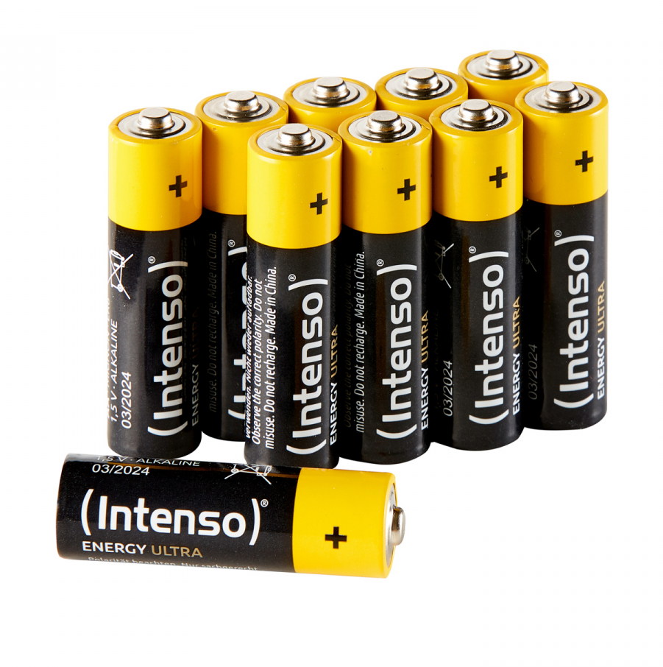
Flashlights and lanterns work perfectly. Don’t forget the extra batteries!

Slide 21
We also need a first aid kit and all our medicines.

Slide 22
In an emergency, there may be important announcements!

Slide 23
We should have a radio or some way to communicate with others and get news.

Slide 24
There are other things we can pack, too. These things are nice to have in an emergency.

Slide 25
We can pack materials to make a fire and heat our food.

Slide 26
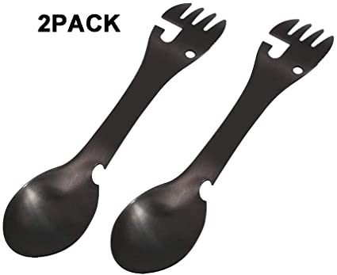
We can pack forks and spoons to eat with.

Slide 27
We can pack wipes or towels to clean with.

Slide 28
We can pack supplies for a pet.

Slide 29
Is there anything else we should bring?

Slide 30
When our bag is packed, we should put it someplace easy to find.

Slide 31
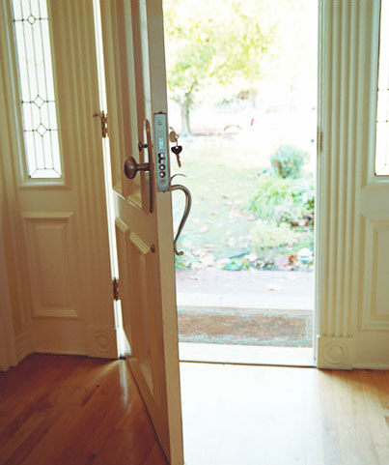
Our bag should be near an exit so we can get it and get out fast!

Slide 32
We probably won’t ever need our bag, but it is good to have one ready!

Slide 33
I am ready for an emergency!

Slide 34
The End

